Slide 1
Java Basics
DHTML and DOM, JavaScript syntax,
Maintainable & Testable JS
…
Java workshop training, August,2017.
Dr. Kishore Biswas (Forrest/柯修)
PhD. Artificial Intelligence—Natural Language Processing.
CanWay IT Training ®.

Slide 2
Contents
1.DHTML and DOM
2.JavaScript syntax
3.Maintainable & Testable JS

Slide 3
1.DHTML and DOM

Slide 4
Dynamic HTML
XHTML
content
CSS
style rules
appearance
manipulate
manipulate
Scripting
Language

Slide 5
DHTML
A combination of technologies used to create animated documents
Not a W3C standard!
Originally, a marketing term used by Netscape and Microsoft
Using scripts, we manipulate HTML content and style properties in reaction to events

Slide 6
HTML DOM

Slide 7
HTML DOM
From W3C:
“A platform- and language-neutral interface that allows programs and scripts to dynamically access and update the content and structure of HTML and XHTML documents.”

Slide 8
DOM and JavaScript
Combined with JavaScript, every element in the HTML document is represented by an object
Elements can be manipulated using the properties and methods of the corresponding objects
Changes in the element properties are immediately reflected by the browser

Slide 9
Accessing HTML Elements
All HTML elements (objects) are accessed through the document object
document itself is automatically created
Several ways to access a specific element
paths in the DOM tree
retrieval by tag
retrieval by ID

Slide 10
HTML DOM Tree

Slide 11
Accessing Elements by Paths
function execute() {
var img = document.images[0]; img.src="lighton.gif"
var inx = document.forms[0].elements[0]; inx.value="xx"
var iny = document.forms["form1"].elements["y"]; iny.value="yy"
}
head
<p><img src="lightoff.gif" alt="light off" id="img1" /></p>
<form id="form1" method="get" action="nosuch"><p>
<input type="text" name="x"/>
<input type="text" name="y"/>
<input type="reset"/></p>
</form>
body

Slide 12
Accessing Elements by Tags
function execute() {
var spans = document.getElementsByTagName("span");
spans[0].style.color="red";
spans[1].style.color="blue";
spans[1].style.fontVariant="small-caps";
}
head
<p>This <span>example</span> is lovely.</p>
<p>But <span>this one</span>is even more!</p>
body

Slide 13
Accessing Elements by ID
function execute() {
var theDiv = document.getElementById("div1");
if (theDiv.style.visibility=="hidden")
{theDiv.style.visibility="visible" }
else {theDiv.style.visibility="hidden" }
}
head
<div id="div1"> This text can be hidden!</div>
body
This technique is more stable w.r.t. document changes (why?)

Slide 14
Element Properties
Elements of different types have different sets of properties and methods
See www.w3schools.com/htmldom/ for a detailed list of element properties and methods
Most elements have the style member
style is an object that represents the style-sheet rules applied over the element

Slide 15
Events

Slide 16
Event Example
<html>
<head>
<title>Simple Events</title>
<script type="text/javascript">
function focusInput() {
var theInput = document.getElementsByTagName("input")[0]
theInput.style.background="yellow" }
function blurInput() {
theInput = document.getElementsByTagName("input")[0]
theInput.style.background="white" }
</script>
</head>

Slide 17
Event Example (cont)
<body>
<p>
<img src="lighton.gif" alt="light bulb"
onmouseover="alert('Mouse Over')" />
</p>
<p>
<input type="text" onfocus="focusInput()"
onblur="blurInput()" />
</p>
</body>
</html>

Slide 18
Event Model
Events usually occur due to users actions
For example, pressing the keyboard, changing a text field, moving the mouse over an element, etc.
An event is represented by an event object that is created upon the event occurrence
Every event has an associated target element
For example, the image over which the mouse clicks

Slide 19
Event Model (cont)
Elements can have registered event listeners which are associated with certain types of events
When an event takes place, the listeners that are registered for this event are invoked
Typically, a listener is described by a scripting code (e.g., JavaScript)
This code is executed upon listener invocation

Slide 20
Inline Listener Registration
The simplest (and most common) way to register a listener is by an attribute assignment:
ontype = "JavaScript code"
For example:
<img src="img.gif" onmouseover="alert('!')" />
The JavaScript code has access to the following objects:
this - the element (e.g., the image defined above)
event - the event object

Slide 21
Some Event Types
load
unload
abort
click
dblclick
mousedown
mousemove
mouseup
mouseover
reset
select
submit
keydown
keypress
keyup
change
blur
focus

Slide 22
Another Example
<html>
<head><title>Event Object Example</title>
<script type="text/javascript">
function execute(e) {
alert(" x: " + e.clientX + ", y: " + e.clientY +
" mouse button: " + e.button); }
</script></head>
<body onmousedown="execute(event)"
style="cursor: pointer;
position:absolute; width:100%; height:100%"> </body>
</html>

Slide 23
Form Validation
In the form element, onsubmit="code" defines a listener with a special functionality
When the form is supposed to be submitted, code is executed before submission
The code can return a Boolean value
e.g., onsubmit="return function()"
If code returns false, submission is cancelled!

Slide 24
Form Validation - Simple Example
<html>
<head><title>Form Validation</title>
<script type="text/javascript">
function validate() {
var theX = document.forms[0].x.value;
var theY = document.forms[0].y.value;
if(theX != theY) { alert("x != y!!"); return false; }
else { return true; }
}
</script>
</head>

Slide 25
Form Validation - Simple Example (cont)
<body>
<form id="email-form" action="myurl" method="get"
onsubmit="return validate()">
<p>
x: <input type="text" name="x" />
y: <input type="text" name="y" />
<input type="submit" />
</p>
</form>
</body>
</html>

Slide 26
Form Validation - Another Example
<head><title>Form Validation</title>
<script type="text/javascript">
function validateEmail(form) {
var emailRegExp = /^\w+\@\w+\.\w+$/;
var theEmail = form.email.value;
if(theEmail.match(emailRegExp)) { return true; }
alert(theEmail + " is not a valid email!");
return false;
}
</script>
</head>

Slide 27
Form Validation - Another Example (cont)
<body>
<form id="email-form" action="myurl" method="get"
onsubmit="return validateEmail()">
<p>
Name: <input type="text" name="Name:" /> <br/>
Email: <input type="text" name="email" />
<input type="submit" />
</p>
</form>
</body>

Slide 28
Form Submission
A form can be submitted without the special submission button
Use the function form.submit() to submit a specific form from JavaScript code

Slide 29

Mouse-Click Events
To register a listener for the click event, use can use the onclick attribute of the element
Apply the style rule cursor:pointer to the element in order to get the pointer effect
Alternatively, you can link to a JavaScript code:
<a href="javascript:code">Click here</a>

Slide 30
Event Flow
<script type="text/javascript">
function f1() { alert("1") }
function f2() { alert("2") }
function f3() { alert("3") }
</script>
<body>
<div onclick="f1()">
<p onclick="f2()">
<img src="lighton.gif" alt="light" onclick="f3()"/>
</p>
</div>
</body>

Slide 31
Event Flow (cont)
When we click on the image, which of the functions should be executed?
Answer: all of them!
In what order?
Two different models:
Microsoft (impl. in IE)
W3C (impl. in Mozilla, Opera 7, Konqueror)

Slide 32
Microsoft Model
Event Bubbling: events propagate through the elements in bottom-up order
i.e., from the most specific to the most general
Whenever an element is visited, its listeners are triggered
In our example: img → p → div

Slide 33
W3C Model
In the W3C model, there are 2 traversals:
Event capturing: top-down
e.g., div → p → img
Event bubbling: bottom-up
e.g., img →p → div
Element 1
Element 2

Slide 34
Event Flow (cont)
A listener can be registered in either the capturing or the bubbling phase
By default, listeners register in the bubbling phase
So, what will be the result of the example code?
An element may choose to stop the flow at any listener execution, by calling event.stopPropagation()
In IE: event.cancelBubble = true

Slide 35
An Example
What will happen if we replace f2 with the following?
function f2(e) {
alert("2");
if(e.stopPropagation) e.stopPropagation();
if(e.cancelBubble!= undefined) e.cancelBubble=true;
}

Slide 36
Dynamic Listener Registration
A listener can be dynamically registered by using JavaScript code
Microsoft:
element.ontype = functionName
element.attachEvent("ontype", functionName)
Note that the function is given as an object
The function is called without arguments
The event can be accessed using window.event

Slide 37
Dynamic Listener Registration (cont)
W3C:
element.ontype = functionName
element.addEventListener("type", functionName, isCapture)
The function is called with event as an argument
If isCapture is true, the listener is registered for the capturing phase

Slide 38
Manipulating the Document Structure

Slide 39
Structure Manipulation
In structure manipulation, we
add/remove/replace HTML elements
change the text under elements
Two approaches:
DOM tree manipulation (W3C specification)
Setting the innerHTML attribute (not a specification)

Slide 40
DOM Tree Manipulation
In this approach, we explicitly
create new nodes
add created nodes to the DOM tree
remove old nodes
To create new nodes, use these methods of document:
document.createElement("tag")
document.createTextNode("text")
document.createAttribute("attname")

Slide 41
DOM Tree Manipulation (cont)
To add and remove children of a specific element, use the following methods:
element.appendChild(newChild)
element.insertBefore(newChild, child)
element.removeChild(child)
element.replaceChild(newChild, oldChild)

Slide 42
An Example
<html>
<head><script type="text/javascript">...</script></head>
<body>
<p>First Paragraph.</p>
<div id="d1"><p id="p1">Second paragraph.</p></div>
<p>
<input type="button" value="replace" onclick="replace(this)" />
</p>
</body>
</html>

Slide 43
An Example (cont)
function replace(button) {
d = document.getElementById("d1");
p = document.getElementById("p1");
h = document.createElement("h1");
text = document.createTextNode("This is a header.");
h.appendChild(text);
d.replaceChild(h,p);
button.disabled=true;
}

Slide 44
The innerHTML Property
The attribute innerHTML attribute of an element is the HTML code embedded inside that element
Hence, you can replace existing content by setting this attribute:
element.innerHTML = "new HTML code"
Not recognized by W3C specifications, but supported by Web browsers

Slide 45
Previous Example with innerHTML
function replace(button) {
d = document.getElementById("d1");
d.innerHTML = "<h1>This is a header<\/h1>";
button.disabled=true;
}

Slide 46
The window Object

Slide 47
The window Object
Built-in object called window
Represents the browser window of the document
Several window objects may co-exist
Separate windows/tabs
Separate frames
Default object – need not specify window to access its properties and methods
window.alert() and alert() are the same

Slide 48
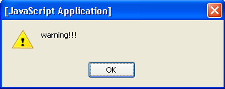
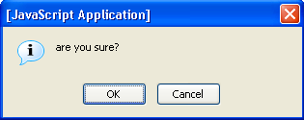
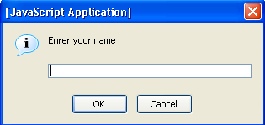
Dialog Boxses
alert("warning!!!");
confirm("are you sure?");
returned value is Boolean
prompt("enter your name");
returned value is either a string or a null object
Rendering stops until box closure!

Slide 49
An Example
<script type="text/javascript">
alert("You are about to start");
document.write("Started<br/>");
conf = confirm("Should I continue?");
if(conf) {
name = prompt("Enrer your name")
document.write("Your name is " + name +".<br/>");
}
</script>

Slide 50
The location Object
The object window.location represents the current URL of the window
For example:
location.href - the current URL (can be changed!)
location.hostname
location.pathname
Also has methods:
location.reload(),
location.replace(‘URL’)

Slide 51
Opening New Windows
window.open("URL") - opens URL in a new window
you can specify other properties, like size, whether it is resizable, etc.
returns the new window object

Slide 52
Accessing Window Frames
window.top - the topmost window
window.frames - a collection of the frames in the window
For example, in a specific frame, use window.top.frames[i] to get to another frame

Slide 53
The navigator Object
The object window.navigator contains information about the browser
For example:
navigator.appName - the name of the browser
navigator.appVersion - the version of the browser
navigator.cookieEnabled
navigator.platform - the OS name

Slide 54
The history Object
The object window.history enables navigation according to the navigation history
For example:
history.back() - same as clicking the back button
history.forward() - same as clicking the forward button
history.go(i) - go forward i times
If i is negative, go back -i times

Slide 55
Javascript and the DOM
Originally, the Document Object Model (DOM) and Javascript were tightly bound
Each major browser line (IE and Netscape) had their own overlapping DOM implementation
There's also some jargon issues, eg. DHTML…
Now, the DOM is a separate standard, and can be manipulated by other languages (eg Java, server side javascript, python, etc)
Browsers still differ in what parts of the standard they support, but things are much better now

Slide 56
Review: DOM Structure
window
* location
* frames
* history
* navigator
* event
* screen
* document
o links
o anchors
o images
o filters
o forms
o applets
o embeds
o plug-ins
o frames
o scripts
o all
o selection
o stylesheets
o body
Objects are in a hierarchy
The window is the parent for a given web page
Document is the child with the objects that are most commonly manipulated
table from: http://www.webmonkey.com/webmonkey/97/32/index1a.html?tw=authoring

Slide 57
DOM Tree
The usual parent/child relationship between node
Like any other tree, you can walk this
diagram from http://www.w3schools.com/htmldom/default.asp

Slide 58
Referencing Objects
Objects can be referenced
by their id or name (this is the easiest way, but you need to make sure a name is unique in the hierarchy)
by their numerical position in the hierarchy, by walking the array that contains them
by their relation to parent, child, or sibling (parentNode, previousSibling, nextSibling, firstChild, lastChild or the childNodes array

Slide 59
A div example
<div id="mydiv">
This is some simple html to display
</div>
the div is an element with an id of mydiv
It contains a text element, which can be referenced by childNodes[0] (childNode being an array of all childen of a node
So the text in the div is not a value of the div, but rather the value of the first (and only) childNode of the div

Slide 60
Zen Garden Example 1
A loop of code to list the links….
for (var i = 0; i < document.links.length; i++)
{
document.write("<b>Link number " + i + " has these properties:</b><br/>");
document.write("<i>nodeName is</i> " + document.links[i].nodeName + "<br/>");
document.write("<i>nodeType is</i> " + document.links[i].nodeType + "<br/>");
document.write("<i>parentNode.nodeValue is</i> " + document.links[i].parentNode.nodeValue + "<br/>");
document.write("<i>firstChild is</i> " + document.links[i].firstChild + "<br/>");
document.write("<i>firstChild.nodeValue is</i> " + document.links[i].firstChild.nodeValue + "<br/>");
document.write("<i>href is</i> " + document.links[i].href + "<br/>");
}

Slide 61
Zen Garden Example 2
Same as example one, but with another loop to look for all span tags….

Slide 62
Zen Garden Example 2
I added a little javascript to the sample file from zen garden
This will search for a given tag using the getElementsByTagName() method
The result of this method is an array, and we can walk that array and then write out different properties and values for the elements found by getElementsByTagName()
There's also a getElementsById() method

Slide 63
Zen Garden Example 2
var look_for="span";
document.write("<p>Looking for " + look_for + " tags</p>");
var x=document.getElementsByTagName(look_for);
for (var i = 0; i < x.length; i++)
{
document.write("<b>Tag " + look_for + " number " + i + " has these properties:</b><br/>");
document.write("<i>nodeName is</i> " + x[i].nodeName + "<br/>");
document.write("<i>nodeValue is</i> " + x[i].nodeValue + "<br/>");
document.write("<i>nodeType is</i> " + x[i].nodeType + "<br/>");
document.write("<i>id is</i> " + x[i].id + "<br/>");
document.write("<i>name is</i> " + x[i].name + "<br/>");
document.write("<i>parentNode is</i> " + x[i].parentNode + "<br/>");
document.write("<i>parentNode.nodeValue is</i> " + x[i].parentNode.nodeValue + "<br/>");
document.write("<i>firstChild is</i> " + x[i].firstChild + "<br/>");
document.write("<i>firstChild.nodeValue is</i> " + x[i].firstChild.nodeValue + "<br/>");
}

Slide 64
Learning The DOM
The only way is to read and try things out
Build a test document, with things you've learned
Gecko_test.html is an example adapted from the mozilla site….

Slide 65
Gecko Test version 1
Notice the use of eval
function setBodyAttr(attr,value)
{
// eval causes a string to be executed
eval('document.body.' + attr + '="' + value + '"');
document.main_form.object_manipulated.value='document.body.'
+ attr + '="' + value + '"';
}
gecko_test01.html

Slide 66
Gecko Test version 1
And a select
<select onChange="setBodyAttr('text',
this.options[this.selectedIndex].value);">
<option value="blue">blue
<option value="green">green
<option value="black">black
<option value="darkblue">darkblue
<option value="white">white
…
</select>
gecko_test01.html

Slide 67
Gecko Test version 1
What's wrong with this? (hint: I'm violating a basic rule of coding…)
gecko_test01.html

Slide 68
Gecko Test version 2
Setting a variable for the options in select (why backslashes at the EOLs?):
var select_string='<option value="blue">blue</option>\
<option value="green">green</option>\
<option value="black">black</option>\
<option value="darkblue">darkblue</option>\
<option value="white">white</option>\
<option value="0xFF5555">0xFF5555</option>';
gecko_test02.html

Slide 69
Gecko Test version 2
And now, I can call that list with a write
How could I further refine this?
<select onchange=
"setBodyAttr('bgColor', this.options[this.selectedIndex].value);">
<script type="application/x-javascript">
document.write(select_string);
</script></select></p>
gecko_test02.html

Slide 70
Manipulating Objects
As said, it's easiest to reference objects by id
To do this easily, use getElementById(), which returns the element with the given id
For example, if you want to find a div with the id of "my_cool_div", use getElementById("my_cool_div")
Keep in mind that it's the element itself that's returned, not any particular property

Slide 71
Using divs
Div properties can be dynamically manipulated
You can use this to make menus more dynamic

Slide 72
colors: The first version
The basic div:
<div id="item1" class="content"
onMouseOver="changeColor('item1', '#fdd');"
onMouseOut="changeColor('item1', '#cff');">
<a href="http://www.unc.edu/">UNC</a><br>
</div>
<br>
colors01.html

Slide 73
colors: The First Version
And a function (notice the alert):
<script>
function changeColor(item, color)
{
document.getElementById(item).style.backgroundColor
=color;
//alert(document.getElementById(item).childNodes[1]);
document.getElementById(item).childNodes[1].style.backgroundColor
=color;
}
</script>
colors01.html

Slide 74
In Action
colors01.html
What's wrong with this? What would be better?

Slide 75
Version 2
The div structure, sans link:
<div id="item1" class="content"
onMouseOver="changeColor('item1', change_color);"
onMouseOut="changeColor('item1', start_color);"
onClick="document.location='http://www.unc.edu';"
>
UNC
</div>
colors02.html

Slide 76
Version 2
And the function, with some vars
<script>
function changeColor(item, color)
{
document.getElementById(item).style.backgroundColor=color;
}
var start_color="#cff";
var change_color="#fdd";
</script>
colors02.html

Slide 77
Version2
Much cleaner
div clickable means no issues with color of link, but sacrifices visited link color (how could that be fixed?)
Use of variables for colors mean it's much easier to change them (but this could be made much easier with php in the background…)

Slide 78
innerHTML
innerHTML is a property of any document element that contains all of the html source and text within that element
This is not a standard property, but widely supported--it's the old school way to manipulate web pages
Much easier than building actual dom subtrees, so it's a good place to start
Very important--innerHTML treats everything as a string, not as DOM objects (that's one reason it's not part of the DOM standard)

Slide 79
Using These….
You can reference any named element with getElementById()
You can read from or write to that element with innerHTML
For example: getElementById("mydiv").innerHTML ="new text string";

Slide 80
A Simple DOM example
<div id="mydiv">
<p>
This some <i>simple</i> html to display
</p>
</div>
<form id="myform">
<input type="button" value="Alert innerHTML of mydiv"
onclick="
alert(getElementById('mydiv').innerHTML)
" />
</form>
simple_dom_example.html

Slide 81
Manipulating Visibility
You can manipulate the visibility of objects, this from http://en.wikipedia.org/wiki/DHTML
The first part displays an element if it's hidden…
function changeDisplayState (id)
{
trigger=document.getElementById("showhide");
target_element=document.getElementById(id);
if (target_element.style.display == 'none'
|| target_element.style.display == "")
{
target_element.style.display = 'block';
trigger.innerHTML = 'Hide example';
}
…
31_dhtml_example.html

Slide 82
Manipulating Visibility
And the second hides the same element if it's visible
…
else
{
target_element.style.display = 'none';
trigger.innerHTML = 'Show example';
}
}
31_dhtml_example.html

Slide 83
Controlling the back end
And you can enable or disable functionality, for example, you can disable links dynamically…
function killAll()
{
var stuff = document.getElementsByTagName("A");
for (var i=0; i<stuff.length; i++)
{
stuff[i].onclick=function()
{
return false ;
}
}
}
source from Mike Harrison via chugalug.org 35_disable_links.html

Slide 84
Controlling the back end
…and reenable them…
function resurrectAll()
{
var stuff = document.getElementsByTagName("A");
for (var i=0; i<stuff.length; i++)
{
stuff[i].onclick=function()
{
return true ;
}
}
}
source from Mike Harrison via chugalug.org 35_disable_links.html

Slide 85
2.JavaScript syntaxes

Slide 86




JavaScript Syntax
Data Types, Variables, Operators, Expressions, Conditional Statements
JavaScript
Basics
SoftUni Team
Technical Trainers
JavaScript Syntax
Software University
http://softuni.bg

Slide 87


Table of Contents
Data Types in JavaScript
Object, Number, Boolean, String
Declaring and Using Variables
Operators, Expressions, Statements
Conditional Statements
If-else, switch-case
False-like Conditions
Falsy/Truthy conditions

Slide 88


Data Types in JavaScript

Slide 89

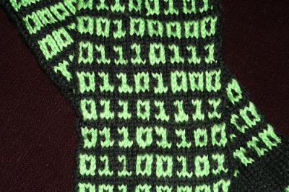
What Is a Data Type?
A data type:
Is a domain of values of similar characteristics
Defines the type of information stored in the computer memory (in a variable)
Examples:
Positive integers: 1, 2, 3, …
Alphabetical characters: a, b, c, …
Dates from the calendar: 1-Nov-2014, 3-Sep-2006, …

Slide 90
JavaScript Data Types
JavaScript is a typeless language
The variable types are not explicitly defined
The type of a variable can be changed at runtime
Variables in JS are declared with the keyword var
DON’T DO THAT!
var count = 5; // variable holds an integer value
count = 'hello'; // the same variable now holds a string
var name = 'Svetlin Nakov'; // variable holds a string
var mark = 5.25; // mark holds a floating-point number

Slide 91
Integer Numbers
Integer types represent whole numbers
In JavaScript integer numbers are in the range from -9007199254740992 to 9007199254740992
The underlying type is a 64-bit floating-point number (IEEE-754)
var maxInteger = 9007199254740992;
var minInteger = -9007199254740992;
var a = 5, b = 3;
var sum = a + b; // 8
var div = a / 0; // Infinity

Slide 92
Floating-Point Numbers
Floating-point types represent real numbers, e.g. 3.75
In JavaScript the floating-point numbers are 64-bit
Stored in the IEEE-754 format
Have range from -1.79e+308 to 1.79e+308
Have precision of 15-16 digits
The smallest positive number is 5.0e-324
Can behave abnormally in the calculations
E.g. 0.1 + 0.2 = 0.30000000000000004

Slide 93
Floating-Point Numbers – Example
var PI = Math.PI, // 3.141592653589793
minValue = Number.MIN_VALUE, // 5e-324
maxValue = Number.MAX_VALUE, // 1.79e+308
div0 = PI / 0, // Infinity
divMinus0 = -PI / 0, // -Infinity
unknown = div0 / divMinus0, // NaN
a = 0.1,
b = 0.2,
sum = 0.3,
equal = (a+b == sum); // false!!!
console.log('a+b = '+ (a+b) + ', sum = ' + sum + ',
sum == a+b? is ' + equal);

Slide 94
Numbers in JavaScript
All numbers in JavaScript are stored internally as double-precision floating-point numbers (64-bit)
According to the IEEE-754 standard
Can be wrapped as objects of type Number
var value = 5;
value = 3.14159;
value = new Number(100); // Number { 100 }
value = value + 1; // 101
var biggestNum = Number.MAX_VALUE;

Slide 95
Numbers Conversion
Convert floating-point to integer number
Convert to integer number with rounding (up to half values)
Convert to integer number with rounding (full integer values)
var valueDouble = 8.75;
var valueInt = Math.floor(valueDouble); // 8
var valueDouble = 8.75;
var valueInt = Math.round(valueDouble); // 9
var valueDouble = 8.75;
var valueInt = Math.floor(valueDouble); // 8
valueDouble = 8.75;
valueInt = Math.ceil(valueDouble); // 9

Slide 96
Number Parsing/Conversion
Convert string to integer
Convert string to float
var str = '1234';
var i = Number(str) + 1; // 1235
var str = '1234.5';
var i = Number(str) + 1; // 1235.5

Slide 97
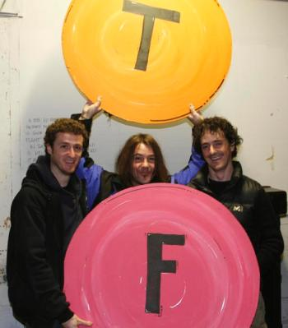
The Boolean Data Type
The Boolean data type:
Has two possible values: true and false
Is useful in logical expressions
Example of Boolean variables:
var a = 1;
var b = 2;
var greaterAB = (a > b);
console.log(greaterAB); // false
var equalA1 = (a == 1);
console.log(equalA1); // true

Slide 98
The String Data Type
The string data type represents a sequence of characters
Strings are enclosed in quotes:
Both ' and " work correctly
Best practices suggest using single quotes
Strings can be concatenated (joined together)
Using the + operator
var s = 'Welcome to JavaScript';
var name = 'Soft' + ' ' + 'Uni';

Slide 99
Strings are Unicode
Strings are stored internally in Unicode
Unicode supports all commonly used alphabets in the world
E.g. Cyrillic, Chinese, Arabic, Greek, etc. scripts
var asSalamuAlaykum = 'السلام عليكم';
alert(asSalamuAlaykum);
var кирилица = 'Това е на кирилица!';
alert(кирилица);
var leafJapanese = '葉'; // Pronounced as "ha"
alert(leafJapanese);

Slide 100
Object Type
Objects in JavaScript hold key-value pairs:
var obj = { name : "SoftUni", age : 2 };
console.log(obj); // Object {name: "SoftUni", age: 2}
obj['site'] = "http://www.softuni.bg";
obj.age = 10;
obj['name'] = "Software University";
console.log(obj); // Object {name: "Software University", age: 10, site: "http://www.softuni.bg"}
delete obj.name;
delete obj.site;
console.log(obj); // Object {age: 10}

Slide 101

Data Types in JavaScript
Data Types
Live Demo

Slide 102



Undefined and Null Values
What is 'undefined' in JavaScript?

Slide 103
Undefined and Null Values
In JS there is a special value undefined
It means the variable has not been defined (no such variable exist in the current context)
Undefined is different than null
Null means that an object exists and is empty (has no value)
var x = 5;
x = undefined;
alert(x); // undefined
x = null;
alert(x); // null

Slide 104
Checking the Type of a Variable
The variable type can be checked at runtime:
var x = 5;
console.log(typeof(x)); // number
console.log(x); // 5
x = new Number(5);
console.log(typeof(x)); // object
console.log(x); // Number {[[PrimitiveValue]]: 5}
x = null;
console.log(typeof(x)); // object
x = undefined;
console.log(typeof(x)); // undefined

Slide 105

Undefined / Null / Typeof
Live Demo

Slide 106

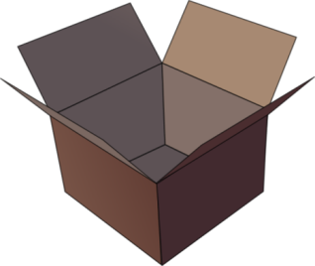
Declaring and Using Variables
p
q
i

Slide 107
What Is a Variable?
A variable is a:
Placeholder of information that can be changed at run-time
A piece of computer memory holding some value
Variables allow you to:
Store information
Retrieve the stored information
Change the stored information
p
q
i

Slide 108

Variable Characteristics
A variable has:
Name
Type (of stored data)
Value
Example:
Name: counter
Type: number
Value: 5
var counter = 5;

Slide 109
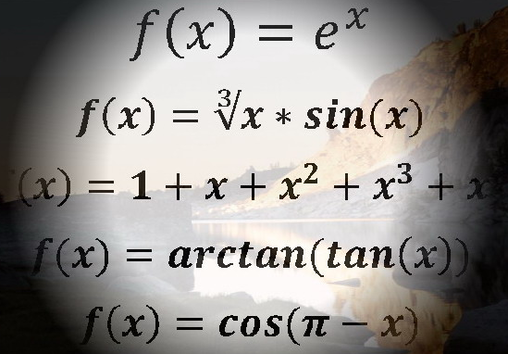
Declaring Variables
When declaring a variable we:
Specify its name (called identifier)
The type is inferred by the value
Give it an initial value
Example:
var
var height = 200;
var str = "Hello";
var obj = { name : 'Peter', age : 19 };

Slide 110

Identifiers
Identifiers may consist of:
Letters (Unicode), digits [0-9], underscore '_', dollar '$'
Cannot start with a digit
Cannot be a JavaScript keyword
Identifiers in JavaScript are case-sensitive
Identifiers should have a descriptive name
Only Latin letters
Variable names: use camelCase
Function names :use camelCase

Slide 111
Identifiers – Examples
Examples of correct identifiers:
Examples of incorrect identifiers:
var New = 2; // Here N is capital, so it's not a JS keyword
var _2Pac = 2; // This identifier begins with _
var поздрав = 'Hello'; // Unicode symbols used
// The following is more appropriate:
var greeting = 'Hello';
var n = 100; // Undescriptive
var numberOfClients = 100; // Descriptive
// Overdescriptive identifier:
var numberOfPrivateClientOfTheFirm = 100;
var new = 5; // new is a keyword
var 2Pac = 2; // Cannot begin with a digit

Slide 112
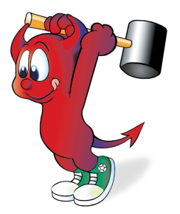
Assigning Values
The = operator is used to assign a value to a variable:
// Assign a value to a variable
var firstValue = 5;
// Using an already declared variable:
var secondValue = firstValue;
// The following cascade calling assigns 3 to firstValue
// and then firstValue to thirdValue, so both variables
// have the value 3 as a result:
var thirdValue = firstValue = 3; // Avoid this!

Slide 113
Local and Global Variables
Local variables
Declared with the keyword var
Global variables
Declared without the keyword var
Stored as properties of the window object
Using global variables is very bad practice!
var a = 5; // a is local in the current scope
a = 'alabala'; // the same a is referenced here
a = 5; // the same as window.a = 5;

Slide 114
Variables in JavaScript
A variable in JavaScript can be:
unresolvable
undefined
null
local
global
Read more here: http://javascriptweblog.wordpress.com/2010/08/16/understanding-undefined-and-preventing-referenceerrors/
console.log(asfd); // ReferenceError
var p = undefined; console.log(p); // undefined
var p = null; console.log(p); // null
var localVar = 5; console.log(localVar); // 5
globalVar = 5; console.log(globalVar); // 5

Slide 115
Unresolvable Variables and Undefined
Unresolvable variables in JavaScript are different than undefined
console.log(msg); // ReferenceError: msg is not defined
var greeting = 'hello'; // A local variable
console.log(greeting); // hello
msg = greeting; // msg is a global variable with value 'hello'
console.log(msg); // hello
msg = undefined; // Different than "delete msg"
console.log(msg); // undefined
console.log(greeting); // hello
delete msg; // Delete a global variable
console.log(msg); // ReferenceError: msg is not defined

Slide 116
Unresolvable Variables – Examples
In this code secondVar is unresolvable:
In this code p is undefined (instead of unresolvable):
var firstVar = 10;
console.log(firstVar); // 10
console.log(secondVar); // ReferenceError: secondVar is not defined
console.log(p); // undefined
var p = undefined;
console.log(p); // undefined
// p is now undefined, it is resolvable

Slide 117
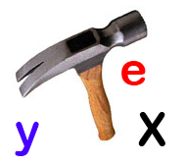
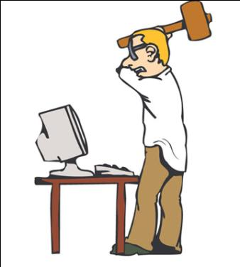
Unresolvable Variables
Live Demo

Slide 118
JavaScript Strict Syntax
It is recommended to enable the "strict syntax"
Converts global variables usage to runtime errors
Disables some of the "bad" JavaScript features
"use strict";
var local = 5; // Local variables will work in strict mode
global = 10; // Uncaught ReferenceError: x is not defined
// This code will not be executed, because of the error above
console.log(5 * 5);

Slide 119

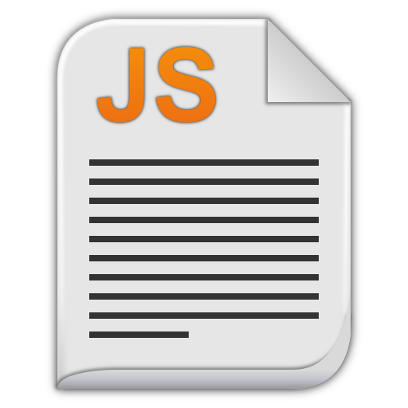

JavaScript Strict Syntax
Live Demo

Slide 120


Operators in JavaScript
Arithmetic, Logical, Comparison, Assignment, …

Slide 121
Arithmetic Operators
Arithmetic operators +, -, *, / are the same as in math
The division operator / returns number or Infinity or NaN
Remainder operator % returns the remainder from division of numbers
Even on real (floating-point) numbers
E.g. 5.3 % 3 → 2.3
The operator ++ / -- increments / decrement a variable
Prefix ++ vs. postfix ++

Slide 122
Logical Operators
Logical || operator returns the first "true" value
Logical && operator returns the first "false" value
var foo = false || 0 || '' || 4 || 'foo' || true;
console.log(foo); // Logs 4, because its the first true value in the expression
var foo = true && 'foo' && '' && 4 && 'foo' && true;
console.log(foo); // Logs '' an empty string, because its the first false value

Slide 123
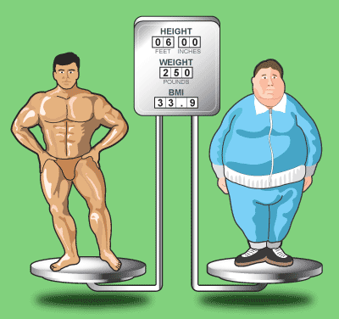
Comparison Operators
Comparison operators are used to compare variables
==, <, >, >=, <=, !=, ===, !==
The == means "equal after type conversion"
The === means "equal and of the same type"
var a = 5;
var b = 4;
console.log(a >= b); // True
console.log(a != b); // True
console.log(a == b); // False
console.log(0 == ""); // True
console.log(0 === ""); // False

Slide 124
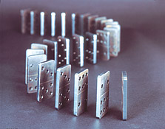
Assignment Operators
Assignment operators are used to assign a value to a variable
=, +=, -=, |=, ...
Assignment operators example:
Variables, with no value assigned, are undefined
var y = 4;
console.log(y *= 2); // 8
var z = y = 3; // y=3 and z=3
console.log(z += 2); // 5
var foo;
console.log(foo); // Logs undefined

Slide 125

Operators in JavaScript
Live Demo

Slide 126
Other Operators
String concatenation operator + is used to concatenate strings
If the second operand is not a string, it is converted to string automatically
Member access operator . is used to access object members
Square brackets [] are used with arrays to access element by index
Parentheses () are used to override the default operator precedence
var output = "The number is : ";
var number = 5;
console.log(output + number);
// The number is : 5

Slide 127
Other Operators (2)
Conditional operator ?: has the form
(if b is true then the result is x else the result is y)
The new operator is used to create new objects
The typeof operator returns the type of the object
this operator references the current context
In JavaScript the value of this depends on how the function is invoked
b ? x : y

Slide 128
Other Operators (3)
var obj = {};
obj.name = "SoftUni";
obj.age = 2;
console.log(obj); // Object {name: "SoftUni", age: 2}
var a = 6;
var b = 4;
console.log(a > b ? "a > b" : "b >= a"); // a>b
var c = b = 3; // b=3; followed by c=3;
console.log(c); // 3
console.log((a+b)/2); // 4.5
console.log(typeof(a)); // number
console.log(typeof([])); // object

Slide 129
Expressions
Expressions are
Sequences of operators, literals and variables that are evaluated to some value
Examples:
var r = (150-20) / 2 + 5; // r=70
// Expression for calculation of circle area
var surface = Math.PI * r * r;
// Expression for calculation of circle perimeter
var perimeter = 2 * Math.PI * r;

Slide 130
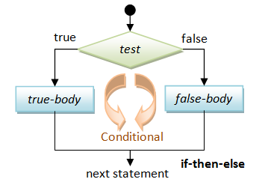
if and if-else
Implementing Conditional Logic

Slide 131
Conditional Statements: if-else
JavaScript implements the classical if / if-else statements:
var number = 5;
if (number % 2 == 0) {
console.log("This number is even.");
}
else {
console.log("This number is odd.");
}

Slide 132

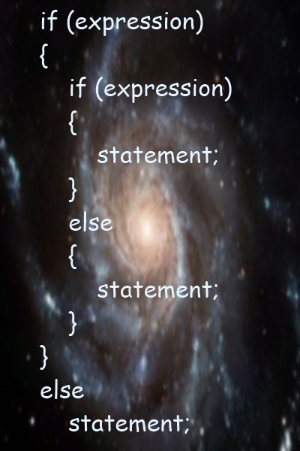
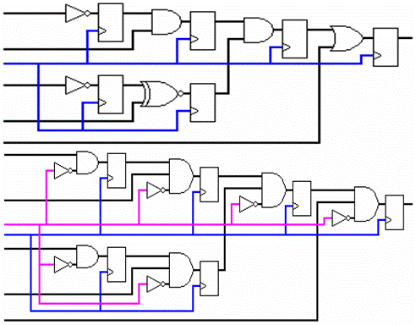
if and if-else
Live Demo

Slide 133

switch-case
Making Several Comparisons at Once

Slide 134
The switch-case Statement
Selects for execution a statement from a list depending on the value of the switch expression
switch (day) {
case 1: console.log('Monday'); break;
case 2: console.log('Tuesday'); break;
case 3: console.log('Wednesday'); break;
case 4: console.log('Thursday'); break;
case 5: console.log('Friday'); break;
case 6: console.log('Saturday'); break;
case 7: console.log('Sunday'); break;
default: console.log('Error!'); break;
}

Slide 135
How switch-case Works?
The expression is evaluated
When one of the constants specified in a case label is equal to the expression
The statement that corresponds to that case is executed
If no case is equal to the expression
If there is default case, it is executed
Otherwise the control is transferred to the end point of the switch statement
The break statement exits the switch-case statement

Slide 136

The switch-case Statement
Live Demo

Slide 137
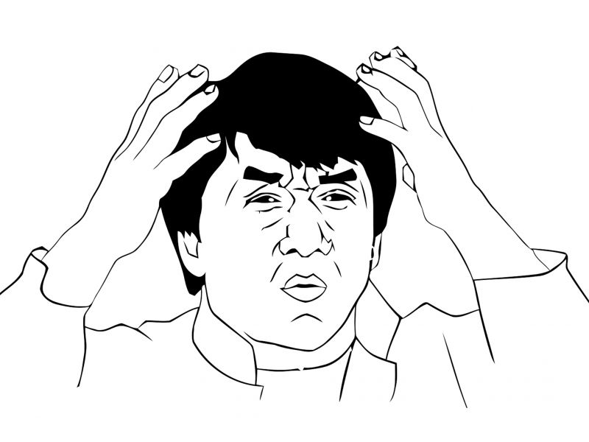
False-like Conditions
Values converted to false
0 == false (zero)
"0" == false (zero as string)
"" == false (empty string)
[] == false (empty array)
Values converted to true
1 == true (one)
"1" == true (one as string)
!0 == true (the opposite of 0)

Slide 138
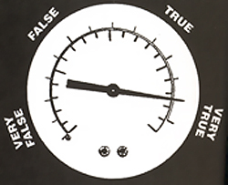

Truthy values in conditions
Values evaluated as truthy in conditions
true // Truthy!
{} // Truthy!
[] // Truthy!
"some string" // Truthy!
3.14 // Truthy!
new Date() // Truthy!

Slide 139
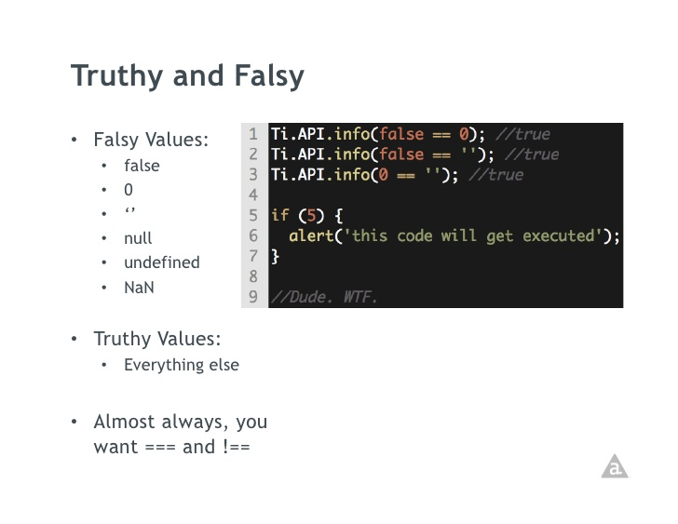
Falsy values in conditions
Values evaluated as falsy in conditions
false // Falsy.
null // Falsy.
undefined // Falsy.
NaN // Falsy.
0 // Falsy.
"" // Falsy.

Slide 140

Unexpected / Strange Behavior in JavaScript
JavaScript is rich of unexpected (for some people) behavior
Learn more at WTF JS: http://wtfjs.com
"0" == false // true
if ("0") console.log(true); // true
[] == false // true
if ([]) console.log(true); // true
null == false // false
!null // true

Slide 141


Summary
JavaScript dynamic data types
Number, String, Boolean, Undefined, Null
Local and Global variables
Operators (same as in C#, Java and C++)
Expressions (same as in C#, Java and C++)
If-else statements (same as in C#, Java and C++)
Switch-case statement (similar to Java / C#)
False-like Conditions
Falsy/Truthy conditions
JS Basics

